Slide 1
ALL COUNTRY Sign Language Recognition System to Help Deaf and Mute People
under the guidance of
Mrs.a.subhalaxmi

Slide 2
Team details
Roll Number Name
203J1A4219 Guntuboina Ravi Vijay Charith
203J1A4221 Jami Sai Raju
203J1A4242 Nahak Kamal Kumar
213J5A4207 Uppala Hemanth Kumar

Slide 3
Table of contents
Abstract
Introduction
Existing System
Proposed System
Algorithm
Results
Conclusion

Slide 4
abstract
This project introduces a revolutionary Sign Language Recognition System designed to empower and enhance communication for individuals who are deaf and mute. By leveraging Cutting-edge technologies, the system aims to bridge the communication gap and improve the quality of life for this community.

Slide 5
introduction
Communication is a fundamental aspect of human interaction, and for individuals who are deaf and mute, sign language serves as a crucial medium. This project acknowledges the challenges faced by this community and proposes an innovative solution – All Country Sign Language Recognition System. The goal is to enable seamless communication through the recognition of sign language gestures using advanced technology.

Slide 6
Existing system
Current methods of communication for the deaf and mute community often rely on traditional Indian sign language interpretation, which may not always be readily available. Manual interpretation is subject to limitations, leading to communication barriers. This project seeks to address these limitations and enhance communication accessibility. In existing system CNN and LSTM algorithms are used.

Slide 7
Proposed System
The proposed All Country Sign Language Recognition System utilizes computer vision / image processing and machine learning to recognize and interpret sign language gestures. By employing advanced algorithms and gesture recognition techniques, the system aims to provide real-time and accurate translation of Indian Sign Language into text or speech. The goal is to create a more inclusive and accessible environment for the deaf and mute community.

Slide 8
Algorithm
1. Data Collection:
Collect a dataset of Indian Sign Language gestures. Ensure that it includes a diverse set of signs with variations in lighting, backgrounds, and hand positions.
2. Data Preprocessing:
Resize images to a consistent size. Normalize pixels to range (e.g., [0, 1]). Augment data diversity (e.g., rotate, flip, zoom).
3. Split Dataset:
Divide the dataset into training, validation, and test sets.
4. Model Architecture:
Experiment with the number of layers, filter sizes, and neurons in the dense layers based on the complexity of your dataset.

Slide 9
Algorithm
5. Compile the Model:
Choose appropriate loss function (e.g., categorical cross entropy for multi-class classification) and an optimizer (e.g., Adam).
6. Model Training:
Train the model using the training set. Adjust hyperparameters, such as learning rate, and monitor performance on the validation set to prevent overfitting.
7. Evaluation:
Evaluate the trained model on the test set using accuracy and other relevant metrics.
8. Fine-Tuning:
Iteratively fine-tune the model based on evaluation results. Experiment with different architectures and hyperparameters if needed.
9. Deployment:
Integrate the trained model into your application or platform.

Slide 10
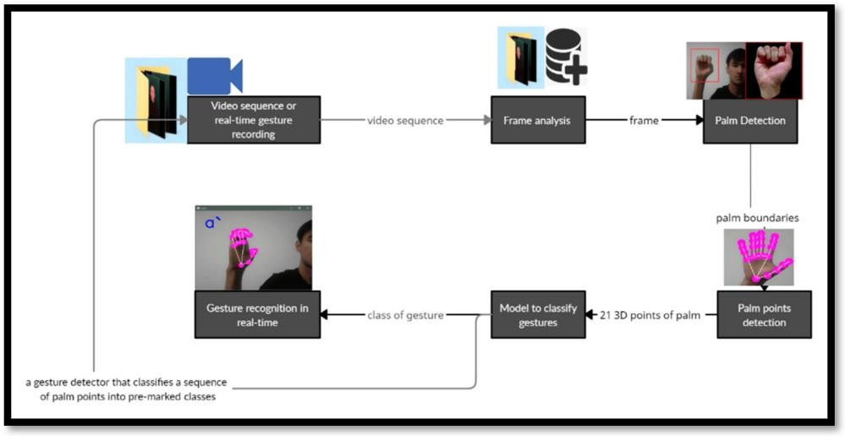
WORK FLOW

Slide 11
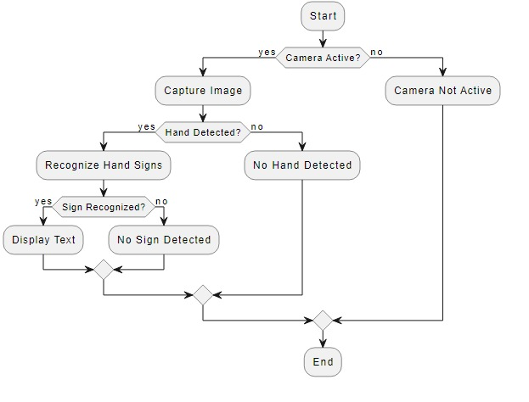
Flow chart

Slide 12
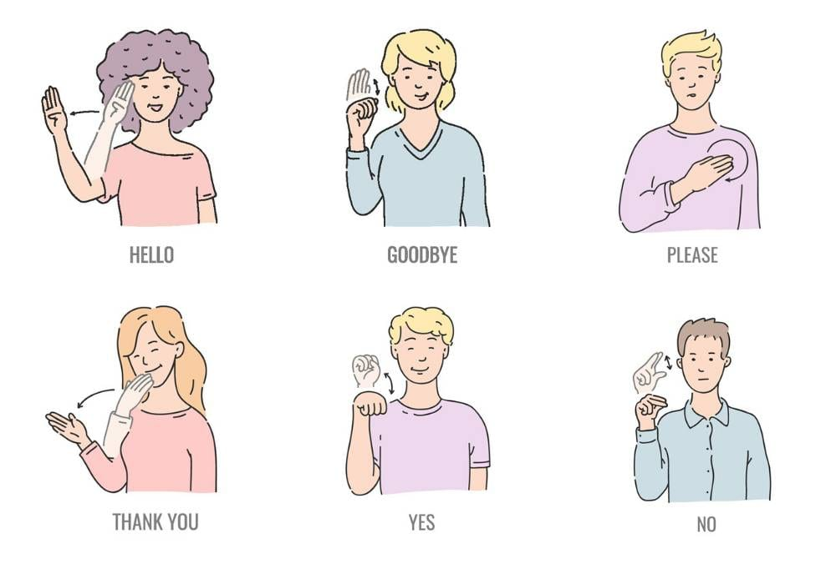
Symbols of sign language
In this sign language people who are deaf and mute are unable to communicate with their voice so they use different symbols for different alphabets.
We use these symbols to train the model and the model will convert these symbols into text or speech.

Slide 13
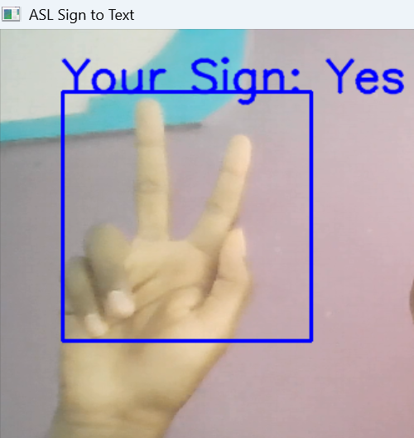
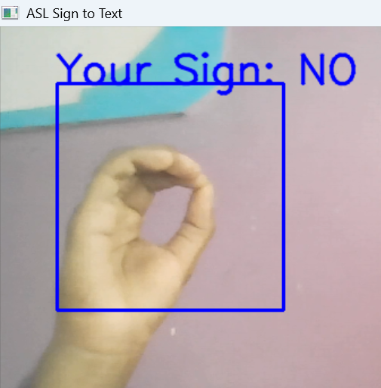
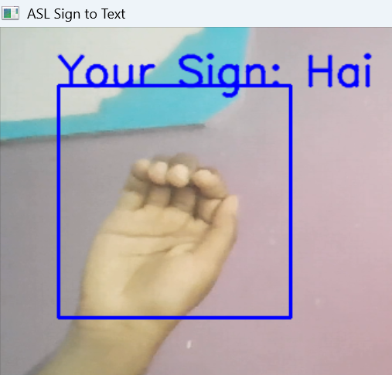
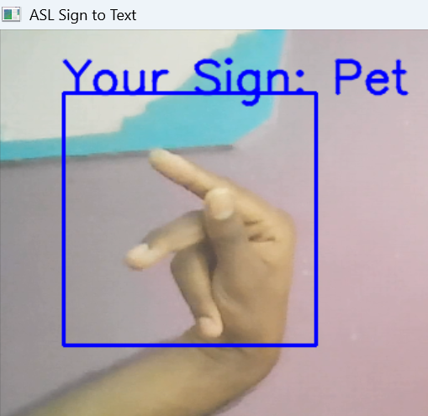
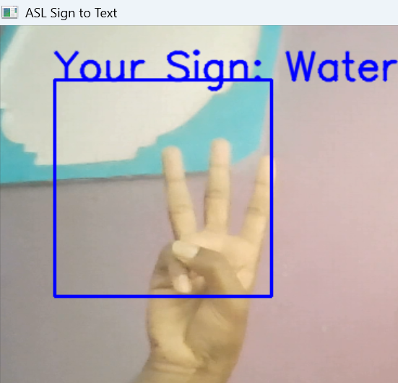
RESULTS

Slide 14
CONCLUSION
In conclusion, the All Country Sign Language Recognition System represents a significant leap forward in providing effective communication tools for the deaf and mute community. By combining computer vision, machine learning, and user-friendly interfaces, this project aims to contribute to a more inclusive society, fostering improved communication and understanding.

Slide 15
Thank you

